Slide 1
FAMILIES WITH HOPE
SAMUEL & WIRDIS PEGUERO

Slide 2
LESSON 3: It’s A Matter of Communication
One of the most special privileges that human beings have is without a doubt the ability to communicate. Expressing what we feel, what we want, and also what we do not want brings people together and allows them to develop functional relationships.

Slide 3
LESSON 3: It’s A Matter of Communication
1. If we approach God, will he listen to us? Jeremiah 33:3.
«Call unto me, and I will answer thee, and show thee great and mighty things, which thou knowest not.».
Answer…

Slide 4
LESSON 3: It’s A Matter of Communication
2. How can we establish a dialogue with God? Ephesians 6:18.
«Praying always with all prayer and supplication in the Spirit, and watching thereunto with all perseverance and supplication for all saints;».
Answer…

Slide 5
LESSON 3: It’s A Matter of Communication
3. Is God willing to answer our prayers? Matthew 21:22; Romans 8:26
«And all things, whatsoever ye shall ask in prayer, believing, ye shall receive».

Slide 6
LESSON 3: It’s A Matter of Communication
«Likewise the Spirit also helpeth our infirmities: for we know not what we should pray for as we ought: but the Spirit itself maketh intercession for us with groanings which cannot be uttered.».
Answer…

Slide 7
LESSON 3: It’s A Matter of Communication
4. Is there a model of prayer that Jesus taught? Matthew 6:9-13.
«After this manner therefore pray ye: Our Father which art in heaven, Hallowed be thy name.
¹⁰ Thy kingdom come, Thy will be done in earth, as it is in heaven…

Slide 8
LESSON 3: It’s A Matter of Communication
Give us this day our daily bread.
And forgive us our debts, as we forgive our debtors.
And lead us not into temptation, but deliver us from evil: For thine is the kingdom, and the power, and the glory, for ever. Amen.».
Answer…

Slide 9
LESSON 3: It’s A Matter of Communication
5. How can humans become true friends with God? Genesis 5:24.
«And Enoch walked with God: and he was not; for God took him.».
Answer…

Slide 10
LESSON 3: It’s A Matter of Communication
6. If a family faces anxiety or anguish over life's problems, what recommendation and promise does the Bible provide? Philippians 4:6-7.
«Be careful for nothing; but in every thing by prayer and supplication with thanksgiving let your requests be made known unto God.».

Slide 11
LESSON 3: It’s A Matter of Communication
«And the peace of God, which passeth all understanding, shall keep your hearts and minds through Christ Jesus.».
Answer…

Slide 12
Let’s Comment …
In our process of getting to know God and share our needs with him, how does his divine wisdom act, especially when we ask for things that might be inconvenient? 1 John 5:14.

Slide 13
MY REACTION…
I understand that talking to God through a prayer is a powerful tool that connects me with him. I want my family to benefit from frequent praying at home and wherever we have the opportunity to do it

Slide 14
PRAYER REQUESTS
My family and personal prayer requests…
______________.
______________.
______________.

Slide 15
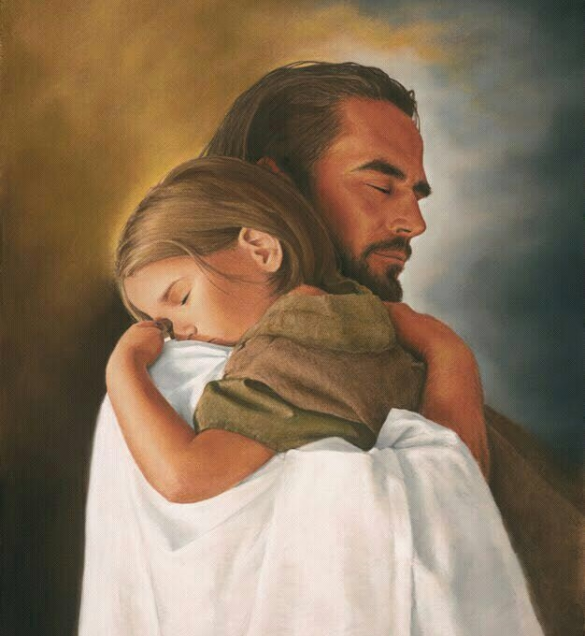
BLESSINGS TO YOUR FAMILY!
A BIG HUG FOR YOU!

