Slide 1
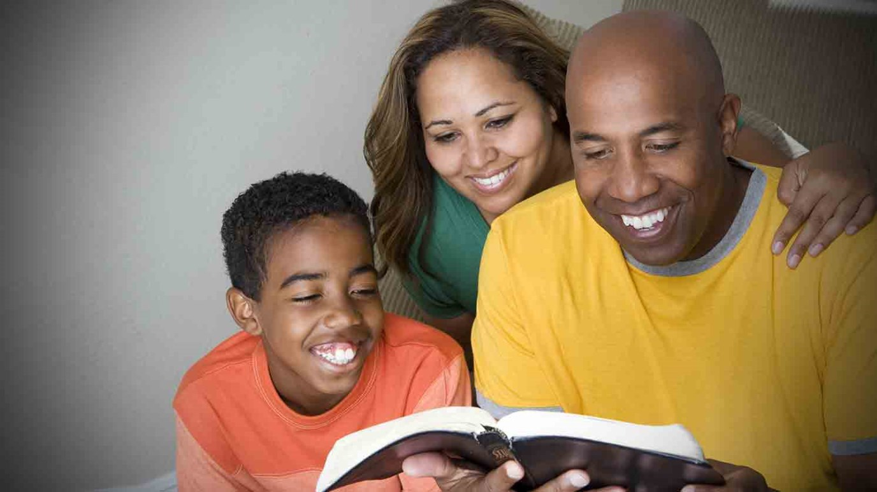
FAMILIES WITH HOPE
SAMUEL & WIRDIS PEGUERO

Slide 2
LESSON 6: REGRET AND FORGIVENESS
They loved each other, indeed, it was true. But it was also true that Martha and Ernesto sometimes offended each other. When one of them made a mistake, both of them and sometimes others were affected. At times they tried to ignore their faults. Little by little their hearts were charged with guilt and remorse .

Slide 3
LESSON 6: REGRET AND FORGIVENESS
1. What certainty does the Bible offer despite our mistakes to achieve God's favor? Luke 5:32 .
«I came not to call the righteous, but sinners to repentance.».
Answer…

Slide 4
LESSON 6: REGRET AND FORGIVENESS
2. What is the reaction experienced by those who have had an encounter with God? Acts 9: 6; 2:37 .
«Now when they heard this, they were pricked in their heart, and said unto Peter and to the rest of the apostles, Men and brethren, what shall we do?».
Answer…

Slide 5
LESSON 6: REGRET AND FORGIVENESS
3. How does God answer man in the face of man's great need for forgiveness? Acts 2:38; 16:31 .
«Then Peter said unto them, Repent, and be baptized every one of you in the name of Jesus Christ for the remission of sins, and ye shall receive the gift of the Holy Ghost.».

Slide 6
LESSON 6: REGRET AND FORGIVENESS
«And they said, Believe on the Lord Jesus Christ, and thou shalt be saved, and thy house.».
Answer…

Slide 7
LESSON 6: REGRET AND FORGIVENESS
4. Is trying to hide our faults worth it? Hebrews 4:13; Proverbs 28:13.
«Neither is there any creature that is not manifest in his sight: but all things are naked and opened unto the eyes of him with whom we have to do.».

Slide 8
LESSON 6: REGRET AND FORGIVENESS
«He that covereth his sins shall not prosper: but whoso confesseth and forsaketh them shall have mercy.».
Answer…

Slide 9
LESSON 6: REGRET AND FORGIVENESS
5. What happens when we repent and confess our sins before God? 1 John 1: 9; Isaiah 55:7.
«If we confess our sins, he is faithful and just to forgive us our sins, and to cleanse us from all unrighteousness.».

Slide 10
LESSON 6: REGRET AND FORGIVENESS
«If we confess our sins, he is faithful and just to forgive us our sins, and to cleanse us from all unrighteousness.».
Answer…

Slide 11
LESSON 6: REGRET AND FORGIVENESS
6. How does a person forgiven by God feel? Psalm 32:1-2.
«Blessed is he whose transgression is forgiven, whose sin is covered.
² Blessed is the man unto whom the Lord imputeth not iniquity, and in whose spirit there is no guile.».
Answer…

Slide 12
Let’s Comment …
It is difficult for man to understand and apply the concept of forgiveness as described in the Bible.
How does what Jesus has done benefit us and how does this affect our relationship with others? Isaiah 43:25.

Slide 13
MY REACTION …
By the grace of God I recognize that I am a sinner. I hope Jesus' forgiveness erases my past sins and by his power I long to be strengthened to live according to his holy will.

Slide 14
PRAYER REQUESTS
My family and personal prayer requests…
______________.
______________.
______________.

Slide 15
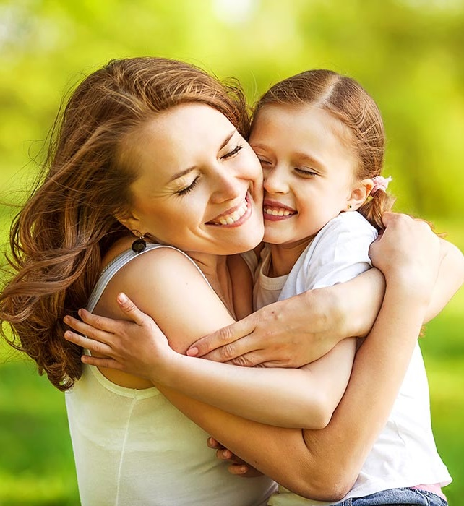
BLESSINGS TO YOUR FAMILY!
A BIG HUG FOR YOU!

