Slide 1
FAMILIES WITH HOPE
SAMUEL & WIRDIS PEGUERO

Slide 2
LESSON 7: FAMILY SAFETY
Walking one day in New York City, Ernest observed numerous cars of different makes and models rolling down the streets. Both him and his wife admired how seriously their drivers took traffic laws. On the other side of the park children played and enjoyed a nice and warm day.

Slide 3
LESSON 7: FAMILY SAFETY
Later that day, they walked by a prison building that they knew was full of prisoners. Then, they asked:
–What would happen if the people in our town had no rules, if no one was judged for a crime no matter what they did? Would you like to live in such a place? –Martha asked.

Slide 4
LESSON 7: FAMILY SAFETY
1. What are the principles that make up God's moral law? Exodus 20:3-17.
Let’s find the verses and read together…
Answer…

Slide 5
LESSON 7: FAMILY SAFETY
2. How does the Bible describe the Holy law of God? Romans 7:12.
«Wherefore the law is holy, and the commandment holy, and just, and good».
Answer…

Slide 6
LESSON 7: FAMILY SAFETY
3. According to the Bible, which of the Ten Commandments is the least important? James 2:10-11.
«For whosoever shall keep the whole law, and yet offend in one point, he is guilty of all”.

Slide 7
LESSON 7: FAMILY SAFETY
For he that said, Do not commit adultery, said also, Do not kill. Now if thou commit no adultery, yet if thou kill, thou art become a transgressor of the law.».
Answer…

Slide 8
LESSON 7: FAMILY SAFETY
4. Did the death of Christ abolish the principles of his law? Matthew 5:17-18; Psalm 111:7-8.
«Think not that I am come to destroy the law, or the prophets: I am not come to destroy, but to fulfil.
¹⁸ For verily I say unto you, Till heaven and earth pass, one jot or one tittle shall in no wise pass from the law, till all be fulfilled.».

Slide 9
LESSON 7: FAMILY SAFETY
«The works of his hands are verity and judgment; all his commandments are sure.
⁸ They stand fast for ever and ever, and are done in truth and uprightness».
Answer…

Slide 10
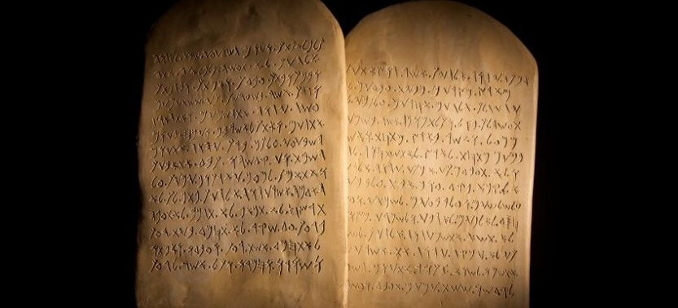
LESSON 7: FAMILY SAFETY
5. How do laws help us understand the problem of sin? 1 John 3: 4; Galatians 3:24.
«Whosoever committeth sin transgresseth also the law: for sin is the transgression of the law.».

Slide 11
LESSON 7: FAMILY SAFETY
«Wherefore the law was our schoolmaster to bring us unto Christ, that we might be justified by faith.».
Answer…

Slide 12
LESSON 7: FAMILY SAFETY
6. What did Jesus say about his friends, in relation to his commandments? John 14:15; 15:10 .
« If ye love me, keep my commandments.».

Slide 13
LESSON 7: FAMILY SAFETY
6. What did Jesus say about his friends, in relation to his commandments? John 14:15; 15:10 .
«If ye keep my commandments, ye shall abide in my love; even as I have kept my Father's commandments, and abide in his love.».

Slide 14
Let’s Comment …
Review the 10 Commandments in Exodus 20 and try to:
Identify how the practice of these principles can bring blessing to your family and how much you might suffer by ignoring them.

Slide 15
MY REACTION …
I understand that the ten commandments of God's law have been given for the blessing of man and for the happiness of families. I want God to let me to put them into practice.

Slide 16
PRAYER REQUESTS
My family and personal prayer requests…
______________.
______________.
______________.

Slide 17
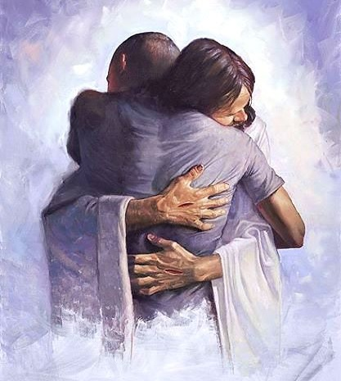
BLESSINGS TO YOUR FAMILY!
A BIG HUG
FOR YOU!

