Slide 1
FAMILIES WITH HOPE
SAMUEL & WIRDIS PEGUERO

Slide 2
LESSON 8: NO TIME FOR THE SPECIAL DATE?
In Ernest and Martha's family, time was becoming increasingly complex. Their family had already gotten bigger with the arrival of two beautiful children, just as they had dreamed. They had their car and lived in a quiet neighborhood. To honor their commitments, they worked hard and had almost no time to share with their family and nor as a couple.

Slide 3
LESSON 8: NO TIME FOR THE SPECIAL DATE?
1. Which special day is that, who designed it and when? Genesis 2:1-2.
«Thus the heavens and the earth were finished, and all the host of them.
² And on the seventh day God ended his work which he had made; and he rested on the seventh day from all his work which he had made.».
Answer…

Slide 4
LESSON 8: NO TIME FOR THE SPECIAL DATE?
2. Who was the reason for this gift? Mark 2:27 .
«And he said unto them, The sabbath was made for man, and not man for the sabbath».
Answer…

Slide 5
LESSON 8: NO TIME FOR THE SPECIAL DATE?
3. What does God expect from his children on this special day? Exodus 20:8-11.
«Remember the sabbath day, to keep it holy.
Six days shalt thou labour, and do all thy work:
But the seventh day is the sabbath of the Lord thy God: in it thou shalt not do any work, thou, nor thy son, nor thy daughter, thy manservant, nor thy maidservant, nor thy cattle…

Slide 6
LESSON 8: NO TIME FOR THE SPECIAL DATE?
nor thy stranger that is within thy gates:
For in six days the Lord made heaven and earth, the sea, and all that in them is, and rested the seventh day: wherefore the Lord blessed the sabbath day, and hallowed it».
Answer…

Slide 7
LESSON 8: NO TIME FOR THE SPECIAL DATE?
4. How does God consider this gift? Ezekiel 20:12.
«Moreover also I gave them my sabbaths, to be a sign between me and them, that they might know that I am the Lord that sanctify them.».
Answer…

Slide 8
LESSON 8: NO TIME FOR THE SPECIAL DATE?
5. At the end of his creation, during his earthly ministry and after his death, on what day did Jesus rest? Genesis 2: 2-3; Luke 23:54-56.
«And that day was the preparation, and the sabbath drew on.

Slide 9
LESSON 8: NO TIME FOR THE SPECIAL DATE?
And the women also, which came with him from Galilee, followed after, and beheld the sepulchre, and how his body was laid.
⁵⁶ And they returned, and prepared spices and ointments; and rested the sabbath day according to the commandment.».
Answer…

Slide 10
LESSON 8: NO TIME FOR THE SPECIAL DATE?
6. Who are we meeting on that day and how long will it last? Isaiah 66:22-23.
«For as the new heavens and the new earth, which I will make, shall remain before me, saith the Lord, so shall your seed and your name remain.

Slide 11
LESSON 8: NO TIME FOR THE SPECIAL DATE?
And it shall come to pass, that from one new moon to another, and from one sabbath to another, shall all flesh come to worship before me, saith the Lord.».
Answer…

Slide 12
Let’s Comment …
How can your family benefit from this day, which is also a divine gift?

Slide 13
MY REACTION …
Today I accept and receive the gift of Saturday as a resting day given by God to man. I want to make a weekly date with God and my family to enjoy this day as he has designed it.

Slide 14
PRAYER REQUESTS
My family and personal prayer requests…
______________.
______________.
______________.

Slide 15
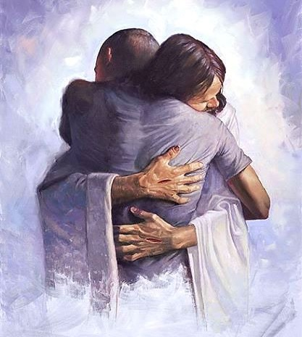
BLESSINGS TO YOUR FAMILY!
A BIG HUG
FOR YOU!

