Slide 1
FAMILIES WITH HOPE
SAMUEL & WIRDIS PEGUERO

Slide 2
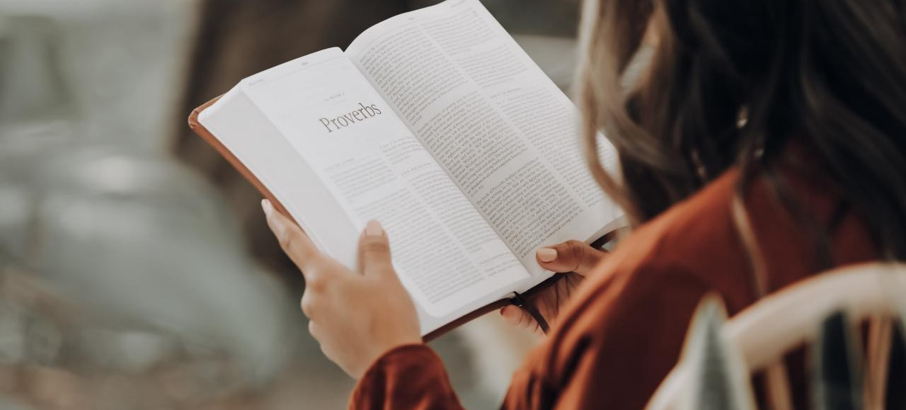
LESSON 10: ¡NO MORE GOODBYES!
They never imagined that this experience could be so sad. Martha and Ernest loved their children and wanted to stay with them forever. Surprisingly, an accident changed the story of their family; they lost the youngest of their children.

Slide 3
LESSON 10: ¡NO MORE GOODBYES!
Although several months went by, words could not express the pain they still felt.
In the midst of these circumstances, when the instructor of this course arrived at their house to share the study of today's lesson, a ray of hope reached their hearts.

Slide 4
LESSON 10: ¡NO MORE GOODBYES!
1. According to the Bible, who is the only one who is immortal? 1 Timothy 6:16.
«Who only hath immortality, dwelling in the light which no man can approach unto; whom no man hath seen, nor can see: to whom be honour and power everlasting. Amen.».
Answer…

Slide 5
LESSON 10: ¡NO MORE GOODBYES!
2. How does death come to us? Genesis 2:17; Romans 5:12.
«But of the tree of the knowledge of good and evil, thou shalt not eat of it: for in the day that thou eatest thereof thou shalt surely die.».

Slide 6
LESSON 10: ¡NO MORE GOODBYES!
«Wherefore, as by one man sin entered into the world, and death by sin; and so death passed upon all men, for that all have sinned».
Answer…

Slide 7
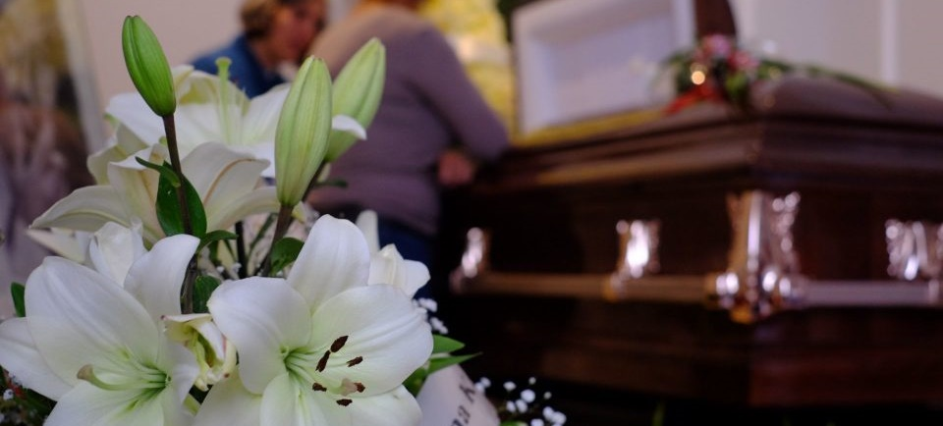
LESSON 10: ¡NO MORE GOODBYES!
3. What happens when a person dies? Genesis 2: 7; Ecclesiastes 12:7.
«And the Lord God formed man of the dust of the ground, and breathed into his nostrils the breath of life; and man became a living soul.».

Slide 8
LESSON 10: ¡NO MORE GOODBYES!
«Then shall the dust return to the earth as it was: and the spirit shall return unto God who gave it.».
Answer…

Slide 9
LESSON 10: ¡NO MORE GOODBYES!
4. What kind of information does the deceased have? Ecclesiastes 9: 5-6; Psalm 146:4.
«For the living know that they shall die: but the dead know not any thing, neither have they any more a reward; for the memory of them is forgotten. Also their love, and their hatred, and their envy, is now perished; neither have they any more a portion for ever in any thing that is done under the sun.
».

Slide 10
LESSON 10: ¡NO MORE GOODBYES!
«His breath goeth forth, he returneth to his earth; in that very day his thoughts perish.».
Answer…

Slide 11
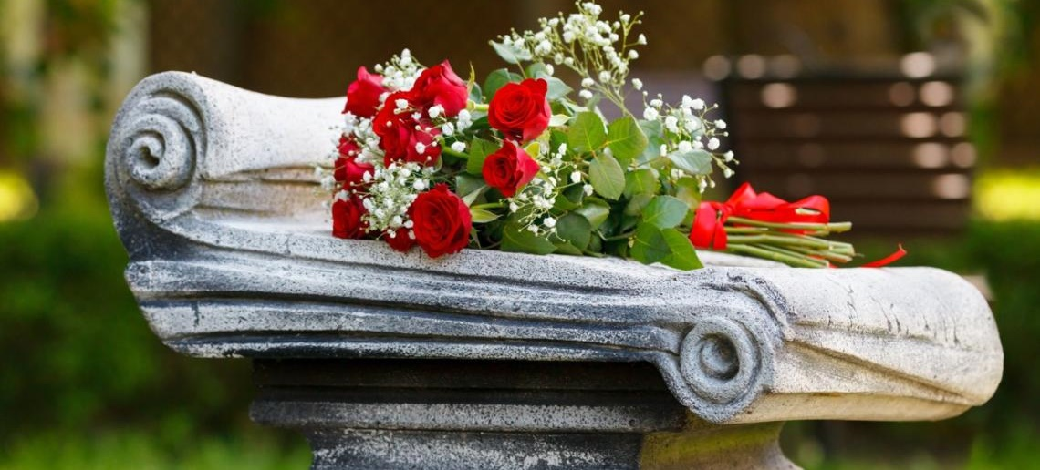
LESSON 10: ¡NO MORE GOODBYES!
5. Nowadays it is common to hear that the dead come out. If they are no longer with the living, who does things on their behalf? Revelations 13: 13-14; Isaiah 8:19-20.

Slide 12
LESSON 10: ¡NO MORE GOODBYES!
«And when they shall say unto you, Seek unto them that have familiar spirits, and unto wizards that peep, and that mutter: should not a people seek unto their God? for the living to the dead?
²⁰ To the law and to the testimony: if they speak not according to this word, it is because there is no light in them.».
Answer…

Slide 13
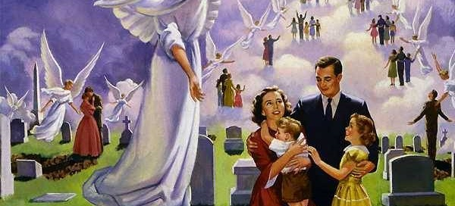
LESSON 10: ¡NO MORE GOODBYES!
6. What great promise does God make to those who accept Jesus and decide to live for him? 1 Thessalonians 4: 13-17; John 11:25.
«But I would not have you to be ignorant, brethren, concerning them which are asleep, that ye sorrow not, even as others which have no hope.».

Slide 14
LESSON 10: ¡NO MORE GOODBYES!
«For if we believe that Jesus died and rose again, even so them also which sleep in Jesus will God bring with him.
¹⁵ For this we say unto you by the word of the Lord, that we which are alive and remain unto the coming of the Lord shall not prevent them which are asleep.

Slide 15
LESSON 10: ¡NO MORE GOODBYES!
«For the Lord himself shall descend from heaven with a shout, with the voice of the archangel, and with the trump of God: and the dead in Christ shall rise first:
¹⁷ Then we which are alive and remain shall be caught up together with them in the clouds, to meet the Lord in the air: and so shall we ever be with the Lord.».

Slide 16
LESSON 10: ¡NO MORE GOODBYES!
«Jesus said unto her, I am the resurrection, and the life: he that believeth in me, though he were dead, yet shall he live:».
Answer…

Slide 17
Let’s Comment …
This seems too good to be true: The opportunity of life after death! Yet the condition set forth by the Bible must be met for this to happen. Given the fact that Jesus died and also rose from the dead,
what does this mean to the human family who have suffered so much but who live for him and believe in his promises?

Slide 18
MY REACTION …
Today I’m clinging to the creator of life, knowing that at his return there will be a great party that will never end. On that day with totally transformed bodies, with no more death or pain, we will live forever with the Lord. Trusting his promises I give myself completely to Jesus.

Slide 19
PRAYER REQUESTS
My family and personal prayer requests…
______________.
______________.
______________.

Slide 20
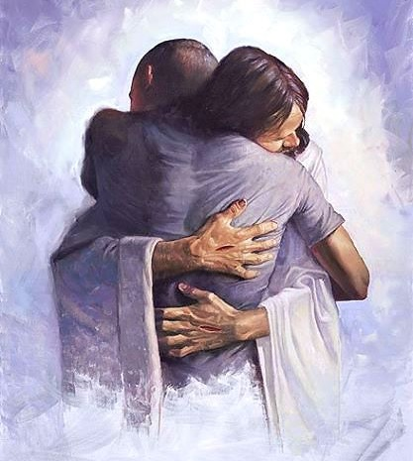
BLESSINGS TO YOUR FAMILY!
A BIG HUG
FOR YOU!

